Slide 1
Introduction to Deep Learning
A gentle introduction to…

Slide 2
Where are we heading?
One of my HOT TAKES in class is that there is a direct line from clustering to Large Language Models (henceforth until the end of the semester, LLMs).
LLMs have transformed how we process, produce, and interpret text-as-data:
Increase accessibility to data
Improve representation of text
Model text through complex processes
LLMs are built on top of an encoder-decoder architecture that looks something like this…

Slide 3
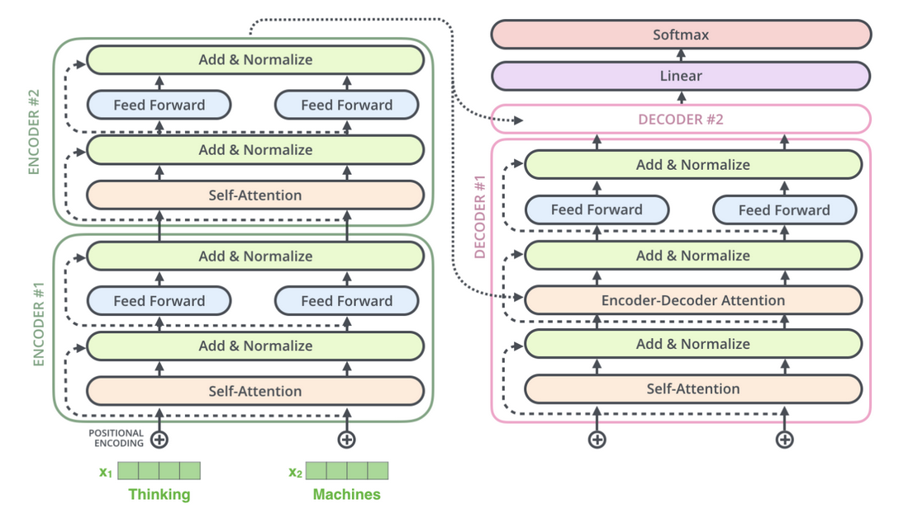

Slide 4
Daunting…
That’s where we are heading… but to understand this, we first need to:
Understand the difference between sparse representation (i.e., dfm) and dense representation of words (i.e., word embeddings).
Have an intuitive understanding of how neural network models operate
Understand attention mechanisms.
Stack all of this into a Transformer architecture.
Let’s start!

Slide 5
Sparce Vectors

Slide 6
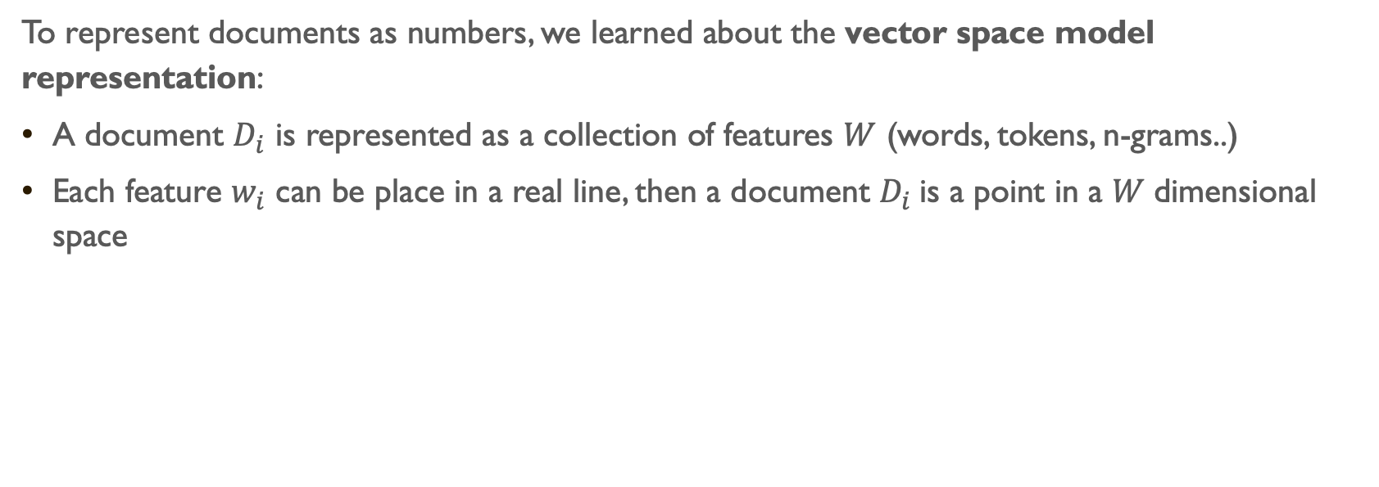
Vector Space Model
To represent documents as numbers, we learned about the vector space model representation:
A document $D_{i}$ is represented as a collection of features $W$ (words, tokens, n-grams..)
Each feature $w_{i}$ can be place in a real line, then a document $D_{i}$is a point in a $W$dimensional space

Slide 7
Take following sentence: “If that is a joke, I love it. If not, can’t wait to unpack that with you later.”
Sorted Vocabulary =(a, can’t, i, if, is, it, joke, later, love, not, that, to, unpack, wait, with, you”)
Feature Representation = (1, 1, 1, 2, 1, 1, 1, 1, 1, 1, 2, 1, 1, 1, 1, 1)
Features will typically be the n-gram (mostly unigram) frequencies of the tokens in the document, or some function of those frequencies
Now each document is a vector (vector space model)
Stacking these vectors will give you our already known representation for text: a Document Feature Matrix

Slide 8
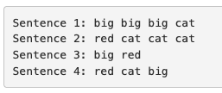
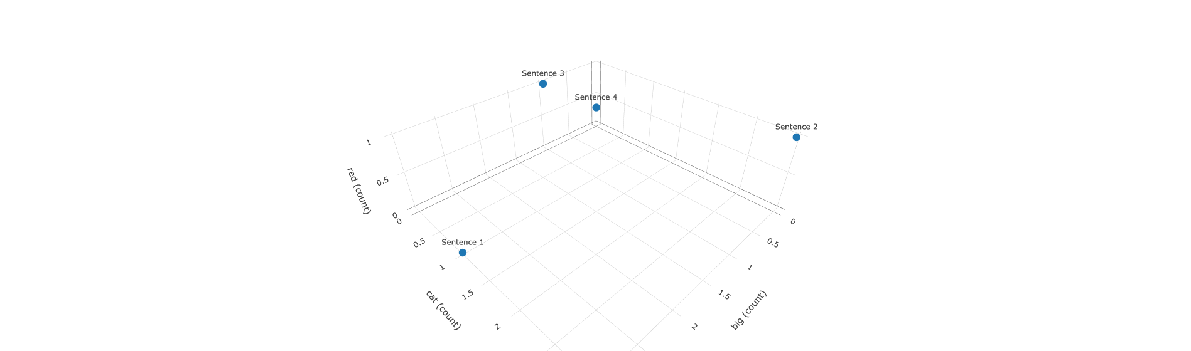

Slide 9


In the vector space, we can use geometry to build well-defined comparison measures between the documents
Distance

Slide 10
The vector space model is quite useful and has been used in many computational linguistics and social science applications of text-as-data:
Descriptive statistics of documents (count words, text-similarity, complexity, etc..)
Supervised Machine Learning Models for Text Classification (dfm becomes the input of the models)
Unsupervised Machine Learning (Topic Models & Clustering)
The underlying intuition is that the occurrence of words in documents is a good approximation to the DGP. And this intuition was used in…

Slide 11
Support Vector Machines (SVM)

Slide 12
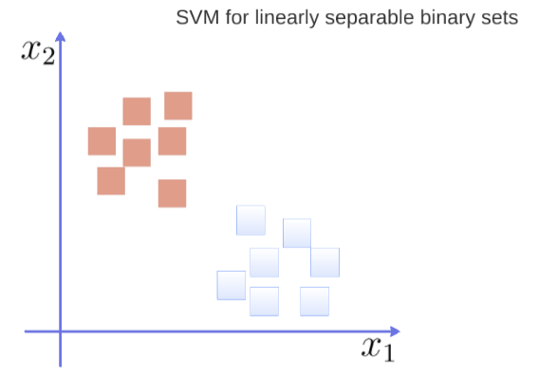

Slide 13
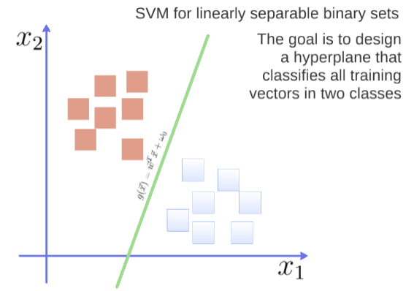

Slide 14
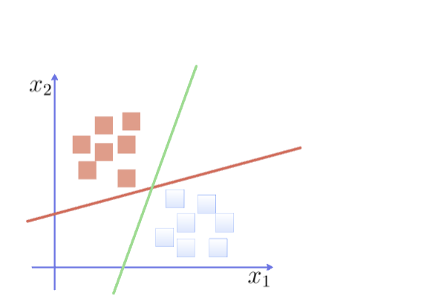

Slide 15
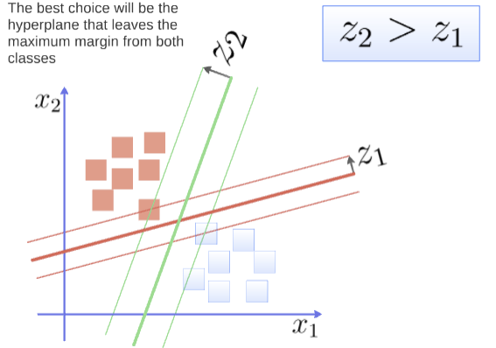

Slide 16
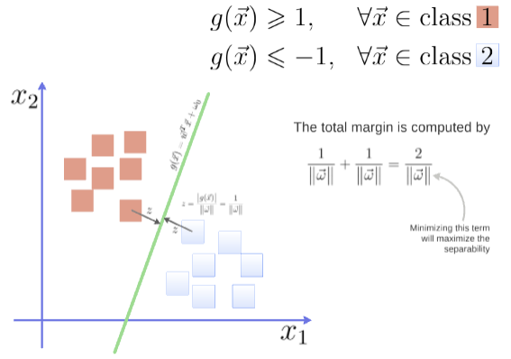
You can see the math at work here: https://www.youtube.com/watch?v=1NxnPkZM9bc

Slide 17
Ok, but what feature do we use in order to classify texts using SVM?
That’s right, word frequencies (e.g., TF-IDF).
And then we just choose a kernel function (i.e., a transformation of the data that allows you to process it more easily).

Slide 18
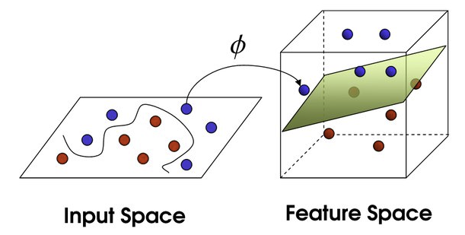
This is also called the kernel trick!

Slide 19
But… underlying this model, there is the idea we represent words as a one-hot encoding.
“cat”: [0,0, 0, 0, 0, 0, 1, 0, ….., V] , on a V dimensional vector
“dog”: [0,0, 0, 0, 0, 0, 0, 1, …., V], on a V dimensional vector
What these vectors look like?
really sparse
those vectors are orthogonal (i.e., cat and dog are completely unrelated)
no natural notion of similarity

Slide 20
Word Embeddings
Let’s add some notion of similarity to these words…

Slide 21
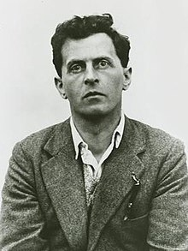
Up until now, we have thought of words as atomic representations of concepts.
Intuitively, we know that this is not the case.
Let’s think for a moment, as we usually do, about Ludwig Wittgenstein

Slide 22
In his Philosophical Investigations (1953), Wittgenstein wrote about language-games, this idea that language is used in context and cannot be understood outside of that context.
Think of the word game: by itself it cannot be understood. But in context:
War games
Board games
Sports
Betting games
“For a large class of cases—though not for all—in which we employ the word ‘meaning,’ it can be defined thus: the meaning of a word is its use in the language.”

Slide 23
Distributional Semantics
This is the distributional hypothesis of language: “you shall know a word by the company it keeps” (J.R. Firth, 1957).
Distributional semantics: words that are used in the same contexts tend to be similar in meaning.
The intuition is as follows:

Slide 24
Cook
i
Chef
Kitchen
Food
Bed
Sleep
Pillow
Mattress
j

Slide 25
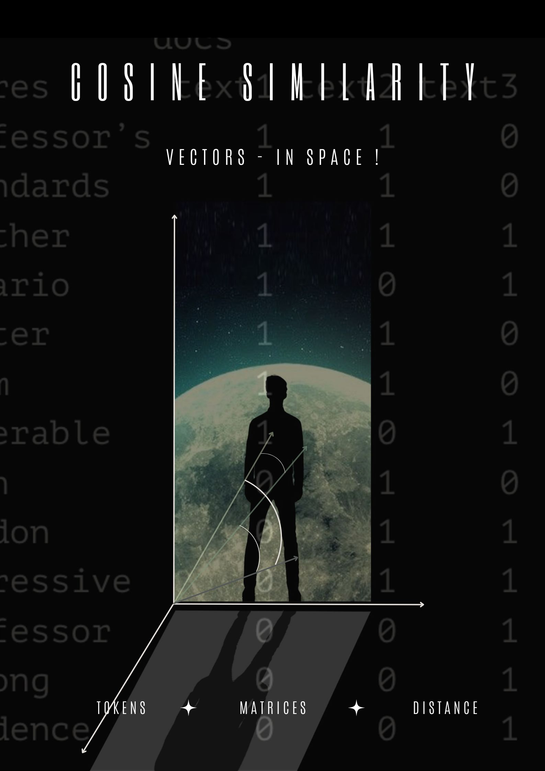

Slide 26
Distributional Semantics
This is the distributional hypothesis of language: “you shall know a word by the company it keeps” (J.R. Firth, 1957).
Distributional semantics: words that are used in the same contexts tend to be similar in meaning.
How can we use this insight to build a word representation?
Move from sparse representation to dense representation
Represent words as vectors of numbers with high number of dimensions
Each feature on this vectors embeds some information from the word (gender? noun? sentiment? stance?)
Learn this representation from unlabeled data.
Ultimately, we want an a priori meaning of words, by looking at ”the company they keep”, the context in which each word is embedded.

Slide 27
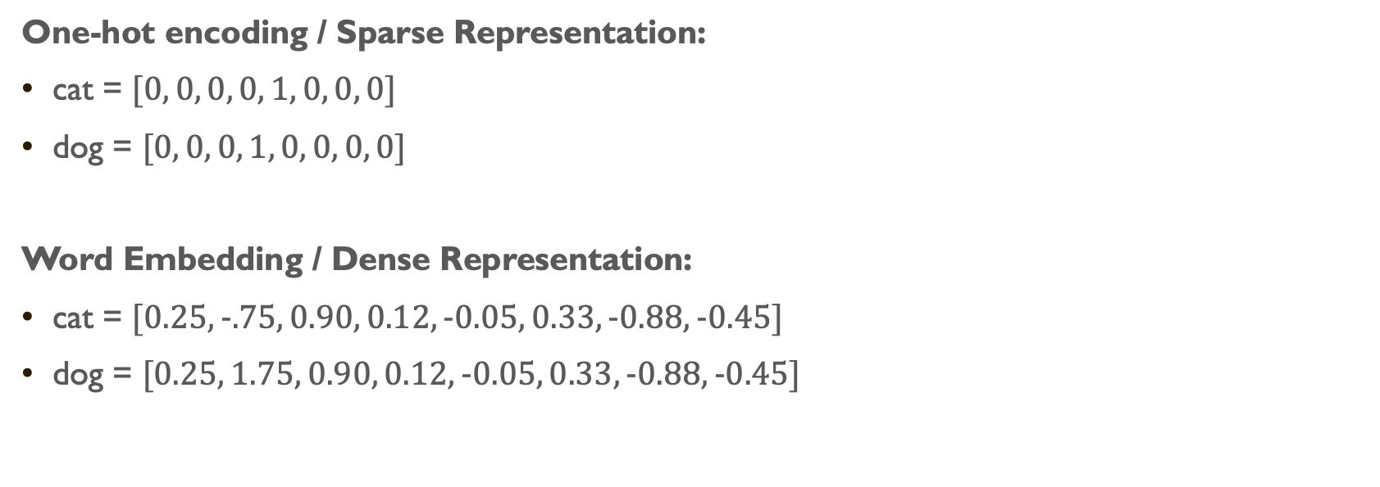
Sparse vs Dense VEctors
One-hot encoding / Sparse Representation:
cat = $[0, 0, 0, 0, 1, 0, 0, 0]$
dog = $[0, 0, 0, 1, 0, 0, 0, 0]$
Word Embedding / Dense Representation:
cat = $[0.25, −.75, 0.90, 0.12, −0.05, 0.33, −0.88, −0.45]$
dog = $[0.25, 1.75, 0.90, 0.12, −0.05, 0.33, −0.88, −0.45]$

Slide 28
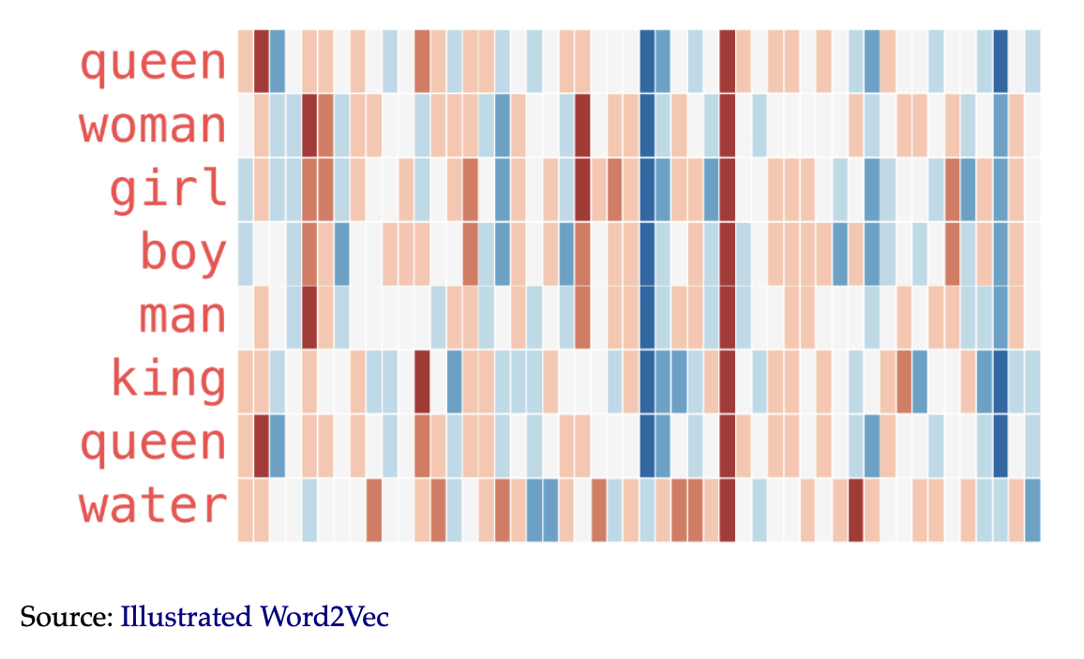

Slide 29
Word Embeddings
Encoding similarity: vectors are not ortogonal anymore!
Automatic Generalization: learn about one word allow us to automatically learn about related words
Encodes Meaning: by learning the context, we can learn what a word means.
As a consequence:
Word Embeddings improve by ORDERS OF MAGNITUDE several text-as-data tasks.
Allows to deal with unseen words.
Form the core idea of state-of-the-art models, such as LLMs.

Slide 30
To understand how we get these wonderful word embeddings, we need to first understand, if only intuitively, how neural networks work.

Slide 31
How do Neural network work?

Slide 32
First, let’s watch a little intro video (YEY): https://www.youtube.com/watch?v=aircAruvnKk

Slide 33
Now, let’s go to our Week 8 code…

Slide 34
Now that we have a clearer understanding (hopefully) of how a neural network works, let’s look at the basics of word embeddings.

Slide 35
Word embeddings
(Now for realsies)

Slide 36
BoW approaches rely on a deeply limited theory of language.
The core idea behind word embeddings is the distributional hypothesis of language: “you shall know a word by the company it keeps’’.

Slide 37
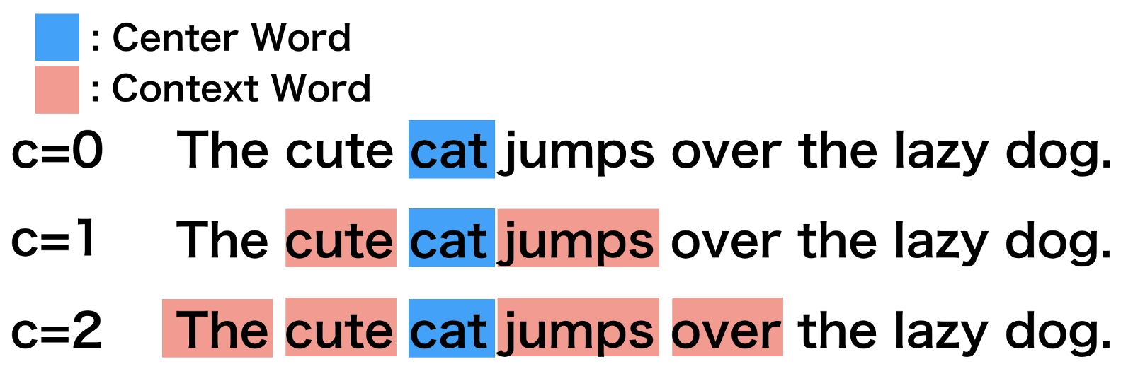

Slide 38
We choose a context window and create a co-occurrence matrix. For example, with a context window of two:
 | The | cute | cat | jumps | over | the | lazy | dog
The | 0 | 1 | 1 | 0 | 0 | 0 | 0 | 0
cute | 1 | 0 | 1 | 1 | 0 | 0 | 0 | 0
cat | 1 | 1 | 0 | 1 | 1 | 0 | 0 | 0
jumps | 0 | 1 | 1 | 0 | 1 | 1 | 0 | 0
over | 0 | 0 | 1 | 1 | 0 | 1 | 1 | 0
the | 0 | 0 | 0 | 1 | 1 | 0 | 1 | 1
lazy | 0 | 0 | 0 | 0 | 1 | 1 | 0 | 1
dog | 0 | 0 | 0 | 0 | 0 | 1 | 1 | 0

Slide 39
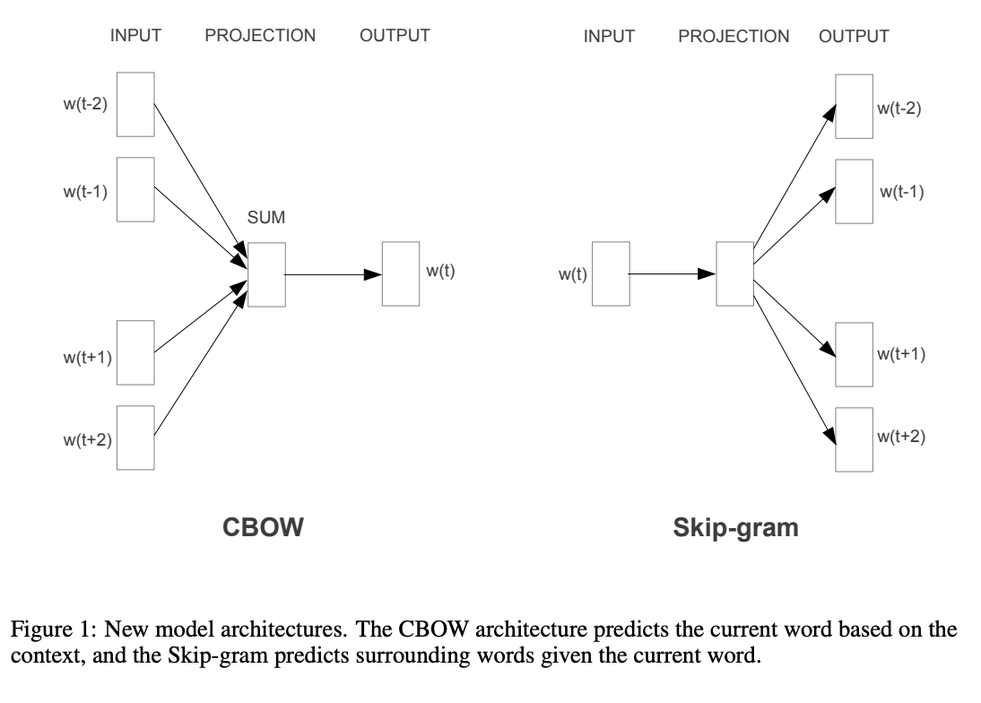

Slide 40
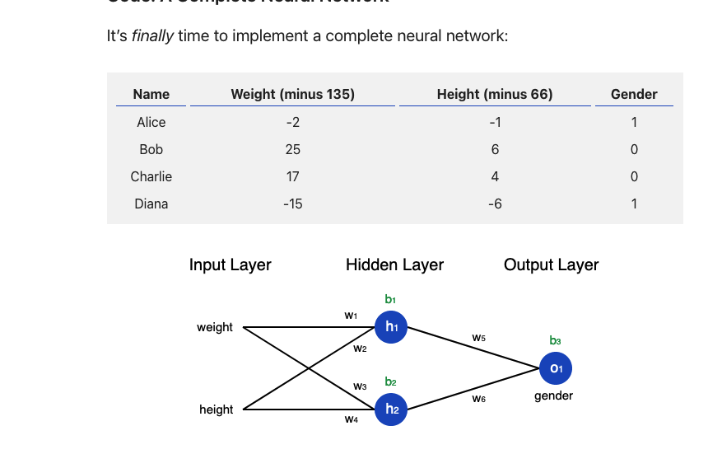
Neural networks…

Slide 41



… but for corpora
$${word}_{t−1}$$
$${word}_{t}$$
$${word}_{t+1}$$

Slide 42

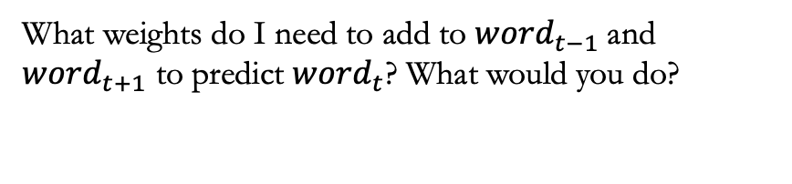
… but for corpora
$${word}_{t−1}$$
$${word}_{t}$$
$${word}_{t+1}$$
What weights do I need to add to ${word}_{t−1}$and ${word}_{t+1}$ to predict ${word}_{t}$? What would you do?

Slide 43
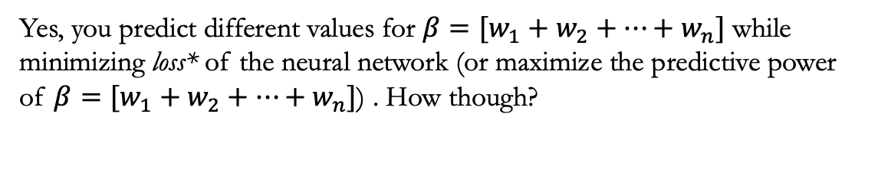
… but for corpora
$${word}_{t−1}$$
$${word}_{t}$$
$${word}_{t+1}$$
Yes, you predict different values for $β=[w_{1}+w_{2}+…+w_{n}]$ while minimizing loss* of the neural network (or maximize the predictive power of $β=[w_{1}+w_{2}+…+w_{n}]$) . How though?

Slide 44
… but for corpora
$${word}_{t−1}$$
$${word}_{t}$$
$${word}_{t+1}$$
Right, again! Using stochastic gradient descent… think about it like MLE but not MLE (since maximizing likelihood is a method of finding the parameters, while neural network is the function defined in terms of those parameters)

Slide 45
… but for corpora
$${word}_{t−1}$$
$${word}_{t}$$
$${word}_{t+1}$$
That’s the word embedding!

Slide 46
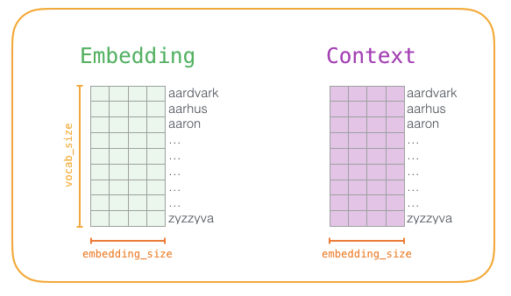
word2vec

Slide 47
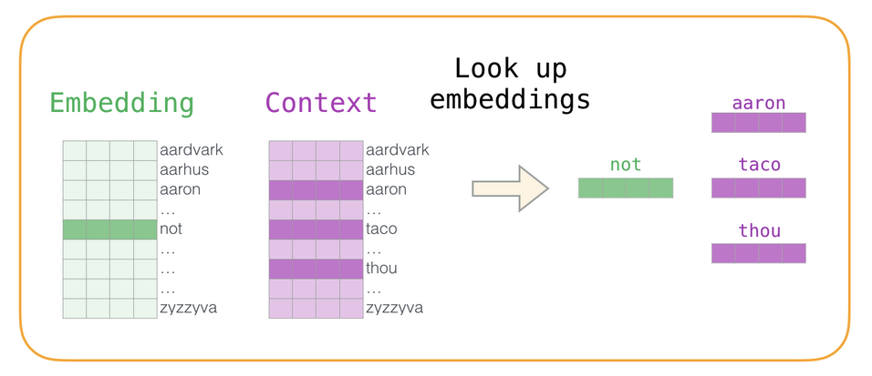

Slide 48
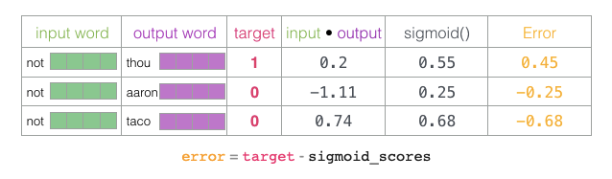

Slide 49
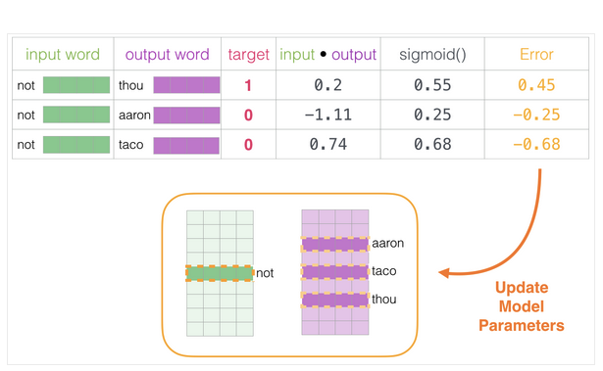

Slide 50
So what?

Slide 51

Encoding similarity:
These embedding have nice and intuitive algebraic properties. Thus:

Slide 53
Automatic Generalization
Which also means that, even if I get a word that not often used in MY corpus, the computer can infer the meaning by looking at the embeddings of other words that are close by.

Slide 54
Measuring meaning
As words get closer in spaces there are more similar in meaning… as they get farther, they get more different in meaning…

Slide 55
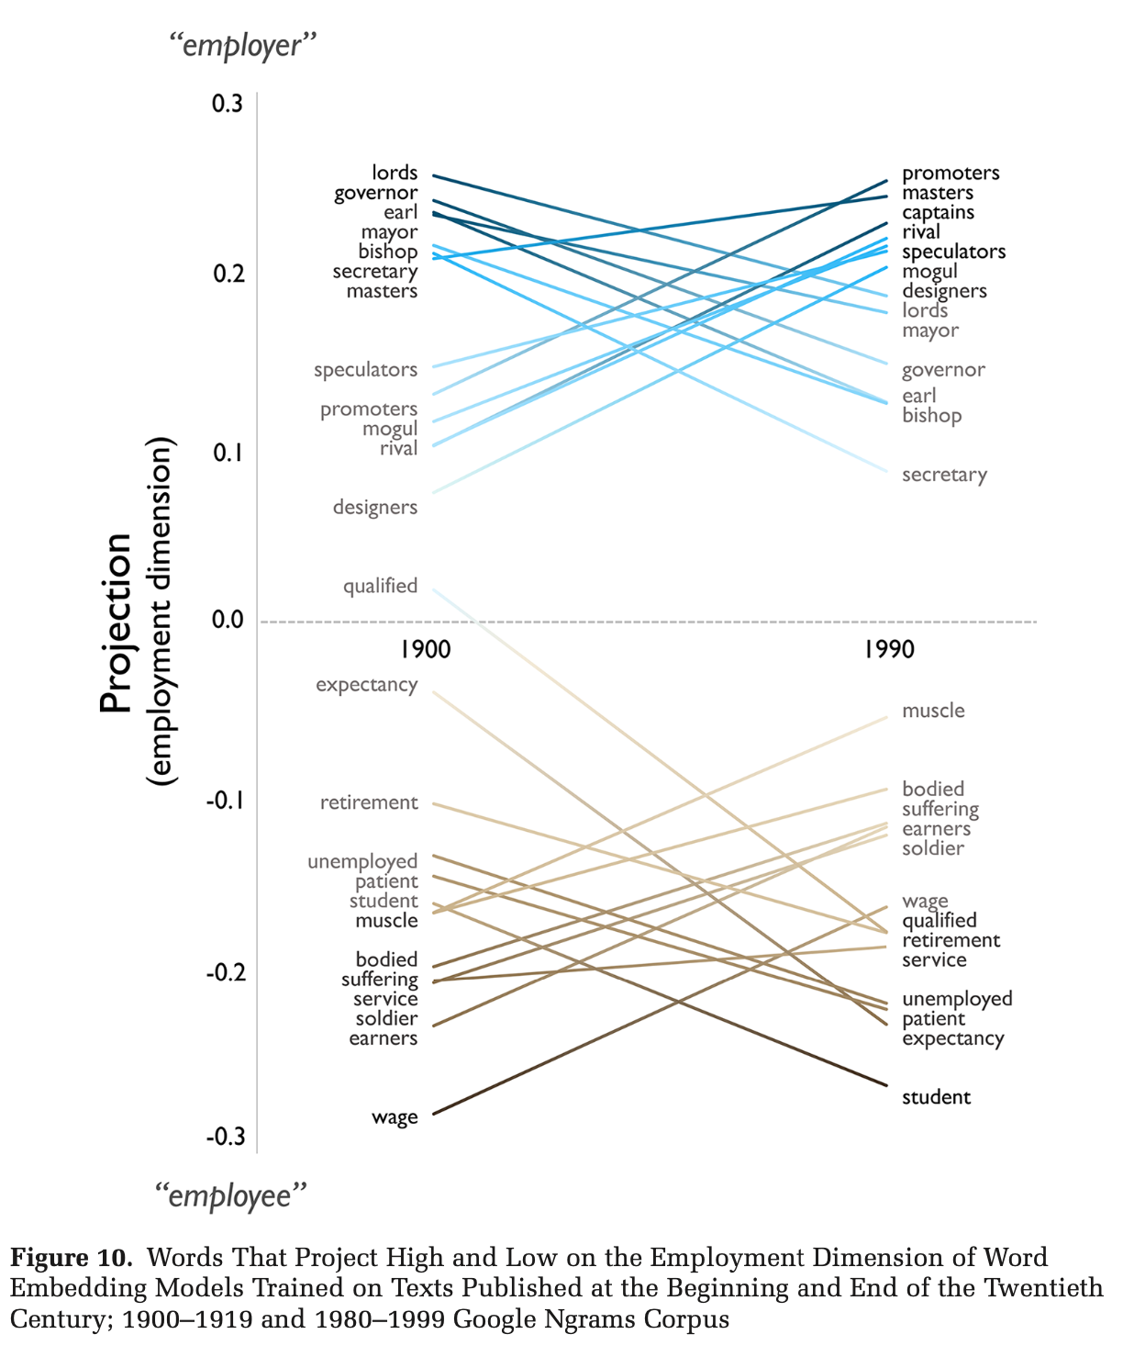

Slide 56
How can we use it? / Why should we care?
There are two general uses for word embeddings:
Use the (variation in the) position of words in relation to each other to make inferences about meaning, ideology, biases, etc. (i.e., unsupervised learning)
Use pre-trained word embeddings to predict categories in text (i.e., supervised learning)

Slide 57
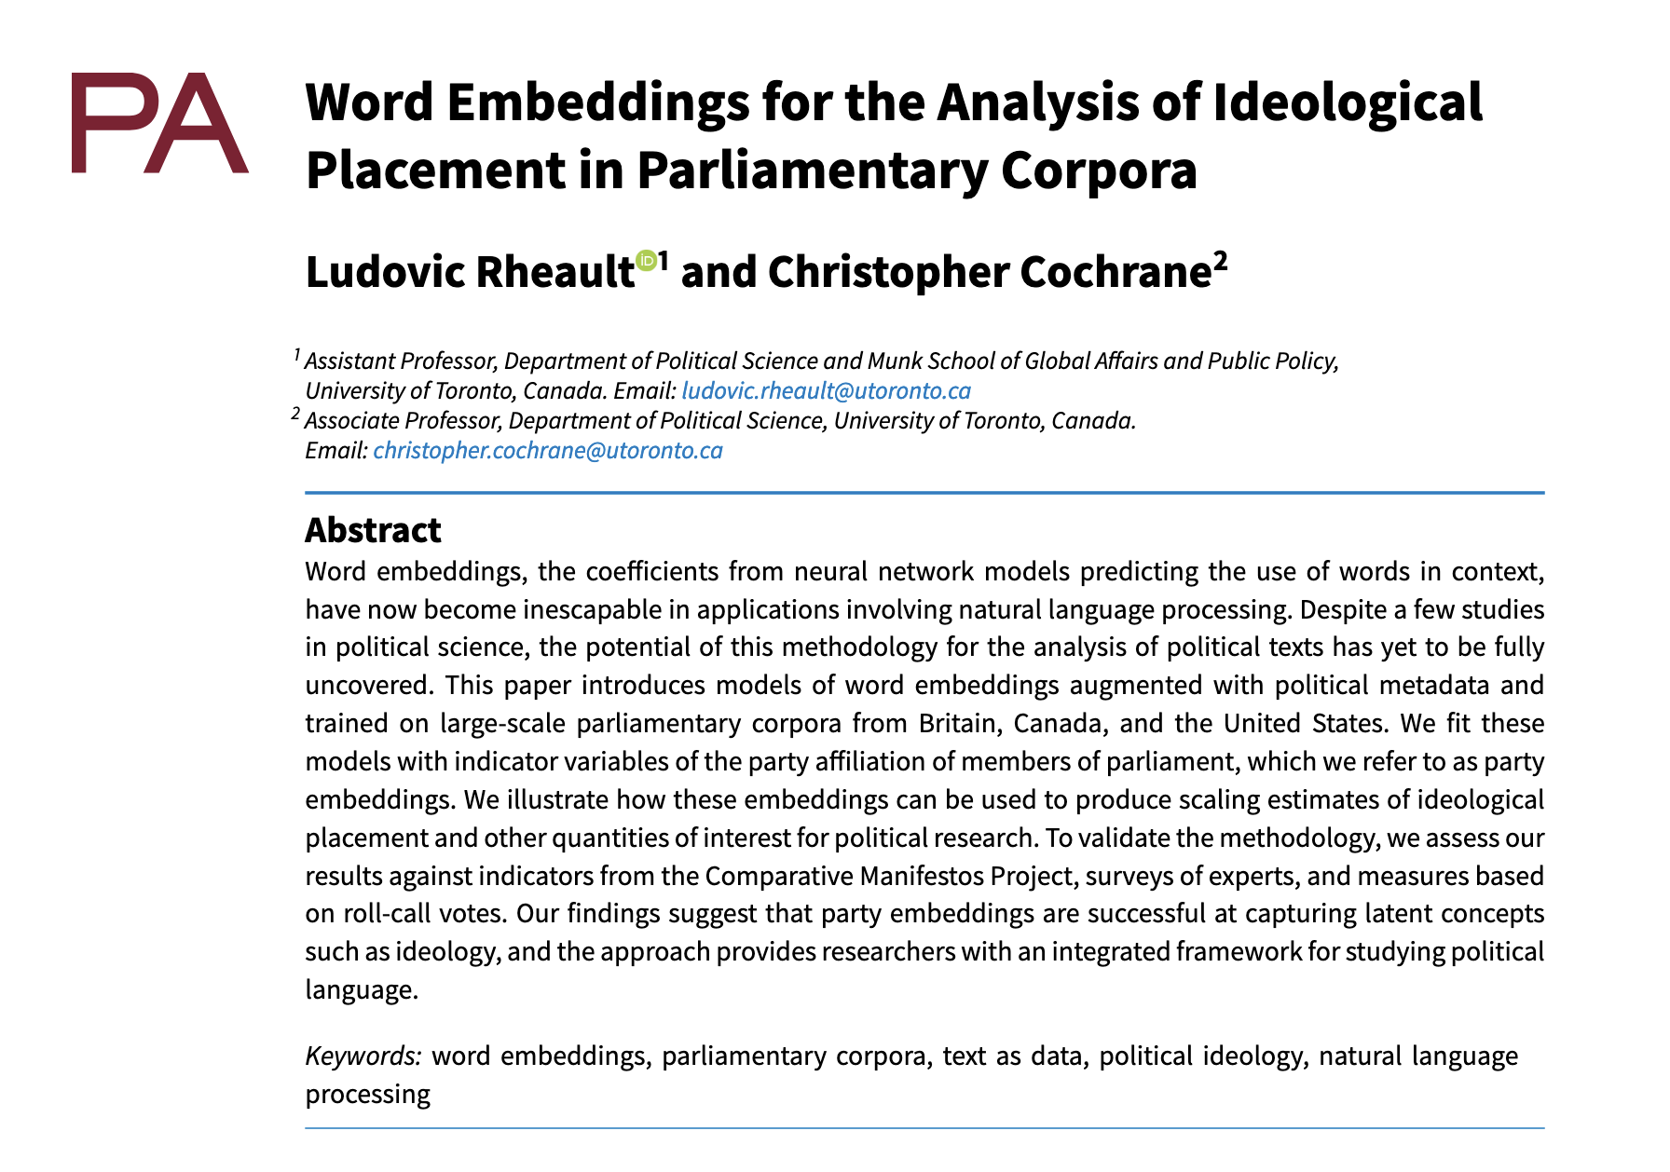
Rheault and Cochrane (2020) – Word Embeddings for the Analysis of Ideological Placement in Parliamentary corpora

Slide 58
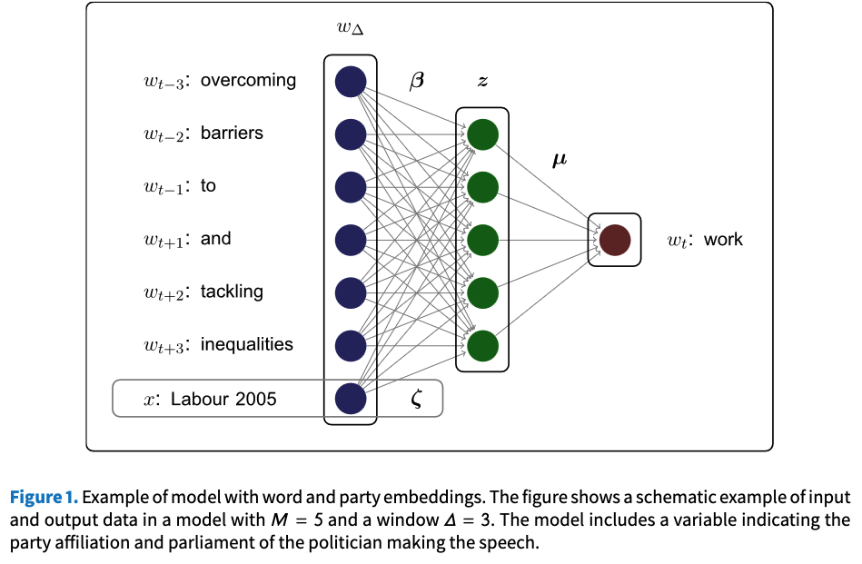

Slide 59
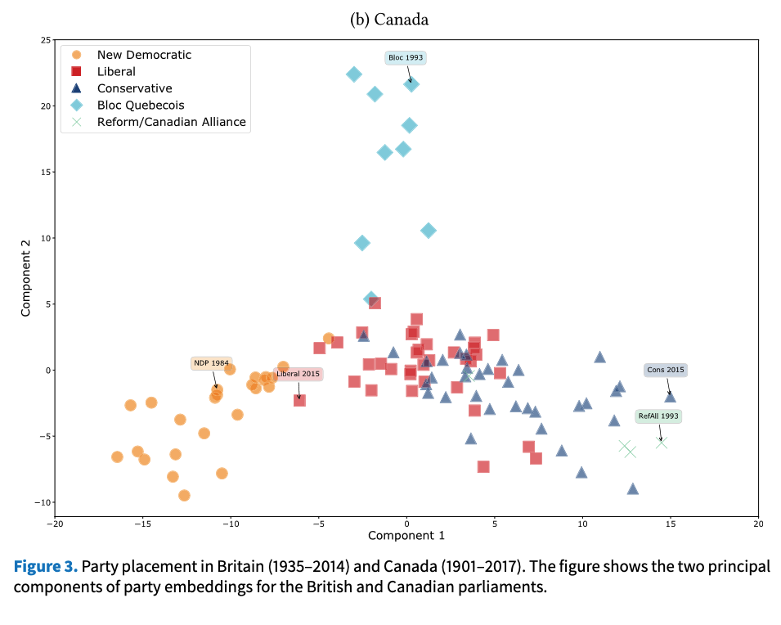

Slide 60
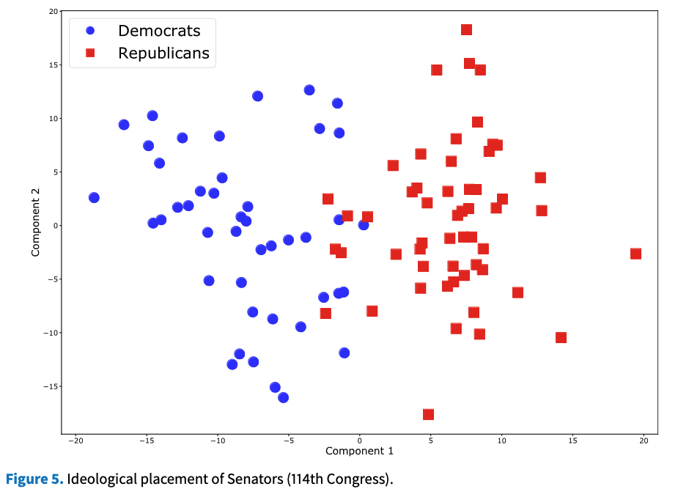

Slide 61
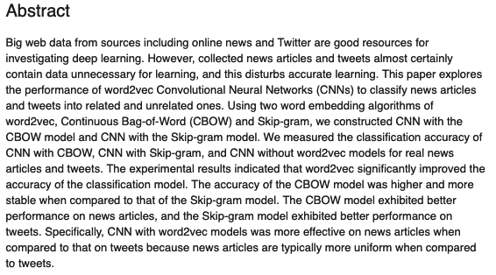
Jang et al. (2019) - Word2vec convolutional neural networks for classification of news articles and tweets

Slide 62
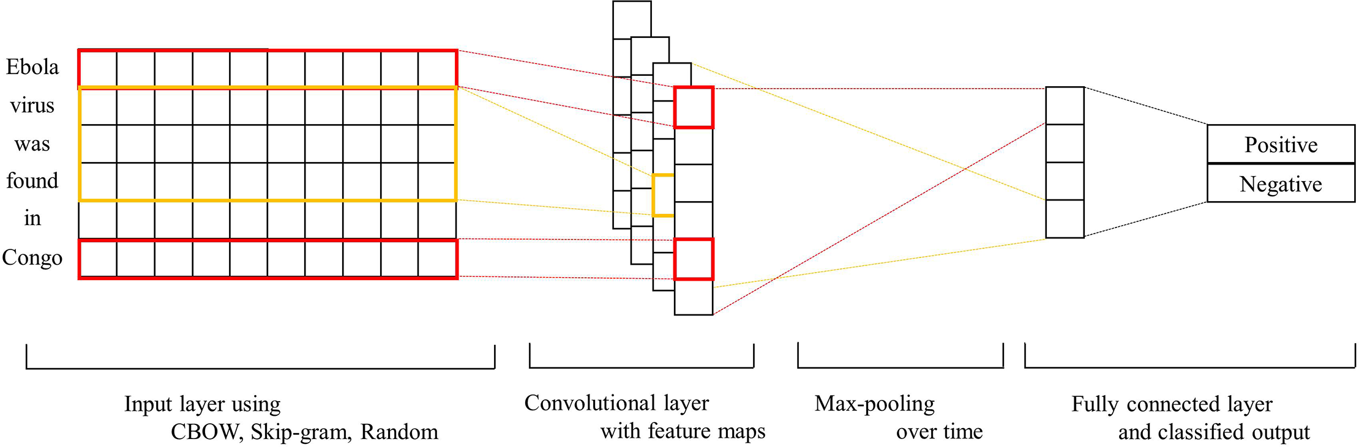

Slide 63
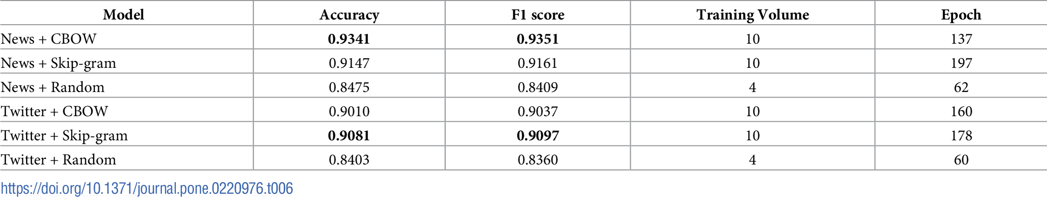

Slide 64
How can we use it? / Why should we care?
There are two general uses for word embeddings:
Use the (variation in the) position of words in relation to each other to make inferences about meaning, ideology, biases, etc. (i.e., unsupervised learning)
Use pre-trained word embeddings to predict categories in text (i.e., supervised learning)
But what if we could get EVEN BETTER representations?

